Slide 1


Intelligent Healthcare Analytics & DevOps Platform
MediPulse
TEAM MEMBERS
Karishma Suthar
2420030384
Diksha Yadav
2420030001
Dhanya Sri
2420030023
Darishma
2420030463
Adaptive Software Engineering — Review 3
Notes:
Introduce the project (MediPulse), the course and Review 2, and the four team members. Mention the guide.

Slide 2




Problem Statement
What problem are we solving?
Data Fragmentation
Patient, appointment, admission, bed and department data sit in separate sources.
Core Problem
Manual Reporting
Hospitals generate large volumes of operational data, but it is often distributed across systems or analyzed manually. This makes it difficult to monitor operations, identify bottlenecks, predict workload and make timely decisions.
Periodic report preparation takes time and limits quick access to insights.
Limited Intelligence
Conventional systems mainly record data, with limited prediction and AI-based recommendations.
Notes:
Hospitals have plenty of data but it is fragmented, reported manually, and rarely used for prediction. These three gaps motivate the project.

Slide 3

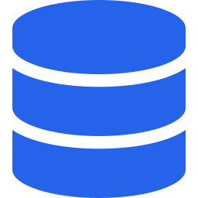






Objectives
What we want to achieve
01
02
03
04
AI-powered hospital data analysis
Integrate and preprocess hospital operational data
Interactive dashboards for monitoring
Analyze patient flow, appointments, beds and resources
05
06
07
08
ML-based demand, workload and occupancy prediction
Identify unusual patterns and bottlenecks
AI-generated insights and recommendations
Analytical reports for administrators
Notes:
Eight objectives running from data integration and dashboards, through ML prediction and anomaly detection, to AI insights and reports for administrators.

Slide 4




Existing System
Current method and its limitations
Current Method
Limitations
Separate systems / data sources
Time-consuming reporting
Manual or periodic reports
No unified AI recommendations
Basic record keeping
Limited real-time visibility
Limited analytics and forecasting
Difficult demand prediction
Mostly reactive decisions
Delayed detection of trends
Notes:
Today's hospital systems are built for record keeping, not intelligence. On the right are the consequences: fragmented data, slow reporting, no forecasting and no unified AI layer.

Slide 5






Proposed System
Our solution and its benefits
PROPOSED SOLUTION
A unified healthcare analytics platform that integrates hospital data, preprocesses it, performs analytics, applies ML/AI, and presents dashboards, reports and AI-assisted recommendations through one interface.
Centralized
Predictive
Intelligent
Multiple hospital datasets in one platform
Demand, workload and bed forecasting
AI trends, anomalies and recommendations
Visual
Actionable
Deployable
Interactive dashboards and KPIs
Supports planning and faster decisions
REST API, PostgreSQL, Docker and cloud
Notes:
One platform that centralizes data, predicts demand, surfaces AI insights, visualizes KPIs, supports decisions, and is deployable through REST API, PostgreSQL, Docker and cloud.

Slide 6




Technology Used
Languages, tools, database and frameworks
Frontend
Backend
AI / ML
AI Assistant
React.js
TypeScript
Tailwind CSS
Spring Boot
Java
REST API
Python • Pandas
NumPy
Scikit-learn
OpenAI API / Ollama
LangChain / LLM
Database
Visualization
DevOps
Deployment
PostgreSQL
Relational database
Chart.js / Recharts
Power BI
Matplotlib
Docker
Git
GitHub
AWS / Azure
Render / Railway
Notes:
A modern, open stack: React + TypeScript frontend, Spring Boot backend, Python for ML, PostgreSQL for storage, and Docker/GitHub with cloud options for DevOps.

Slide 7




Workflow
How the system works, step by step
01
02
03
Hospital Data
Data Preprocessing
Data Analysis
CSV / Database / HMS
Cleaning • validation • transformation
Trends • patient flow • utilization
04
05
06
ML Prediction
AI Insights
Dashboard & Reports
Demand • workload • bed occupancy
Anomalies • bottlenecks • recommendations
KPIs • charts • reports • AI assistant
Hospital administrators receive centralized, predictive and AI-assisted insights
Notes:
Walk the six steps: ingest hospital data, preprocess, analyze, predict with ML, generate AI insights, then deliver everything through dashboards, reports and the AI assistant.

Slide 8






Modules
Main modules and features
Patient Management
Resource Utilization
Patient records, admissions and discharge analysis
Staff, equipment and service utilization
Appointment Analytics
AI Insights
Appointment trends and waiting-time analysis
Trends, anomalies and recommendations
Bed Management
Reports
Bed occupancy, availability and forecasting
Hospital and department analytical reports
Department Analytics
AI Analytics Assistant
Department-wise load and performance
Natural-language questions over analytics
Notes:
Five analytics modules for hospital operations, plus three intelligence modules: AI insights, reports and the natural-language AI assistant (shown in teal).

Slide 9
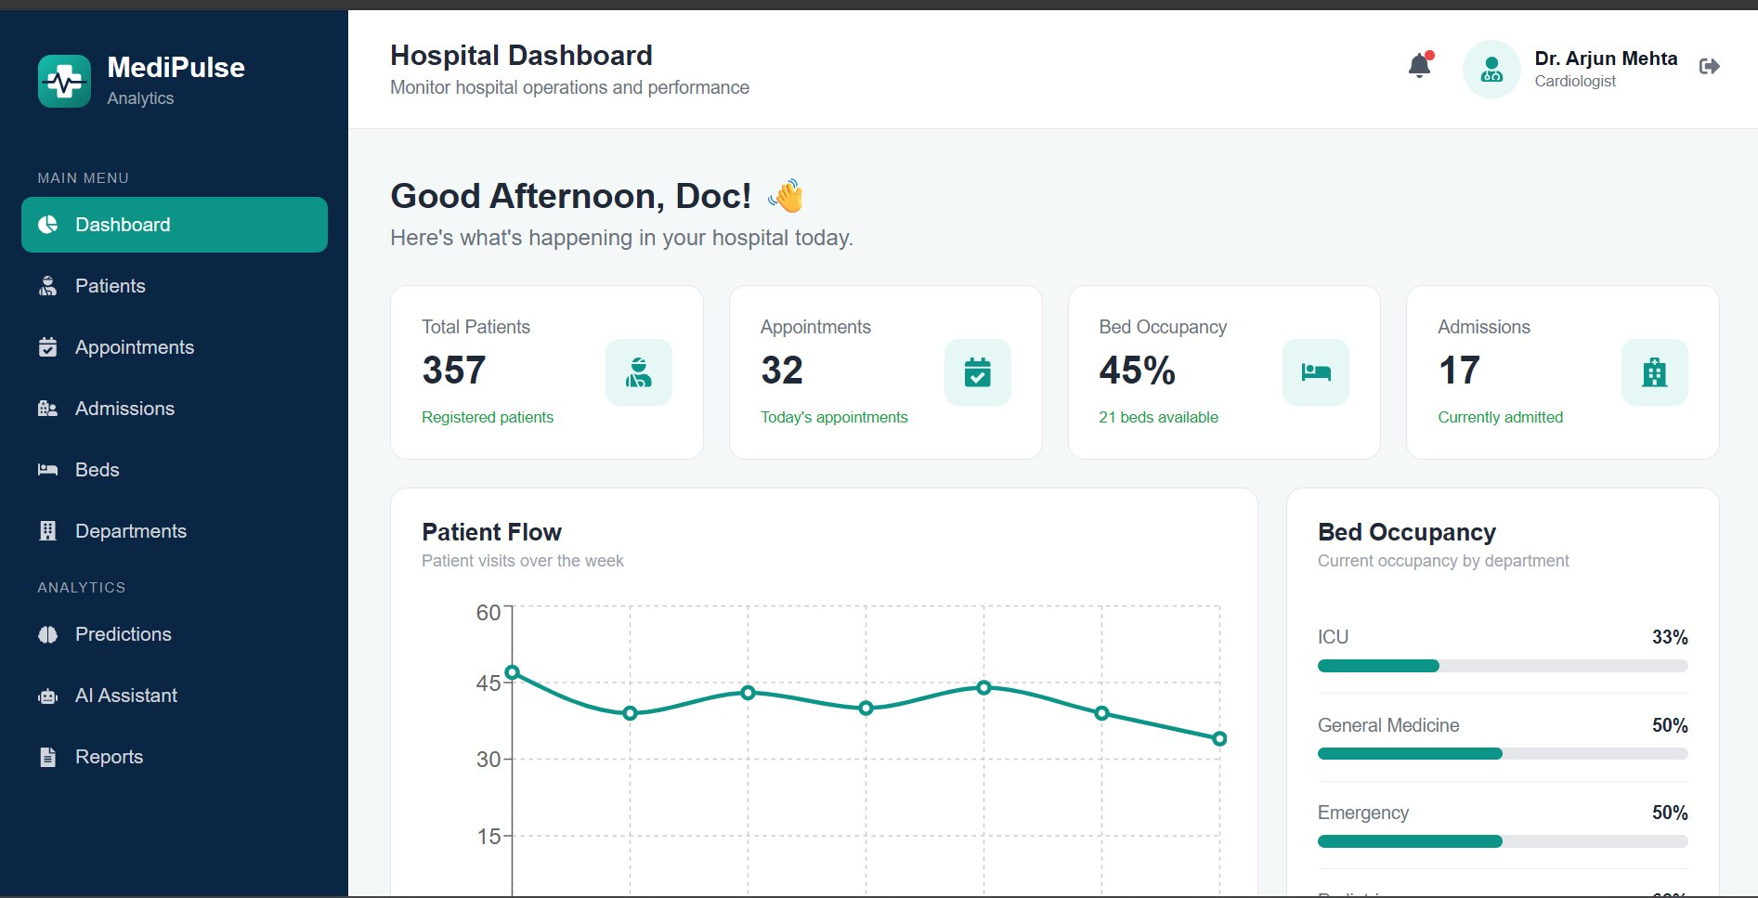
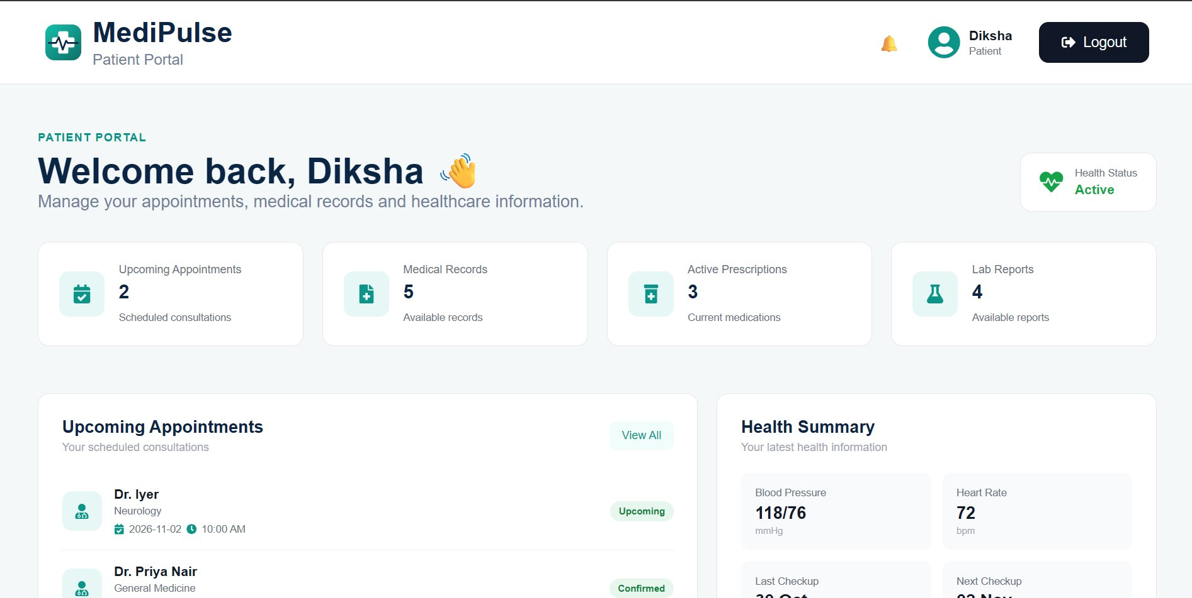



Implementation
MediPulse front-end screens built so far
Analytics Dashboard
Patient Portal
Hospital KPIs, weekly patient flow and bed occupancy by department.
Appointments, medical records, prescriptions, lab reports and health summary.
React + TypeScript UI
Doctor and patient views
APIs and database next
Notes:
Show the two screens: the admin/doctor analytics dashboard with KPIs, patient flow and bed occupancy, and the patient portal with appointments, records, prescriptions and lab reports.

Slide 10

Conclusion & Future Scope
Current Status
A unified approach to hospital analytics: preprocessing, ML, AI, dashboards and DevOps.
Done: project structure, documentation, architecture planning and Git/GitHub setup.
Thank You | Questions?
Notes:
Summarize: architecture, documentation and repository are in place, and the front-end screens exist. Remaining work is the end-to-end integration listed on the right. Invite questions.

